Slide 1
secure data hiding in images using steganography
CAPSTONE PROJECT
Presented By:Sankeerthana Boini
Student Name : Sankeerthana Boini
College Name & Department : Parul University(B.tech CSE-CYBERSECURITY)

Slide 2
OUTLINE
Problem Statement
Technology used
Wow factor
End users
Result
Conclusion
Git-hub Link
Future scope

Slide 3
Problem Statement
The project "Steganography - Hide a Secret Text Message in an Image" is designed to provide a graphical user interface (GUI) for securely embedding and retrieving text messages within image files. The main objective is to utilize the concept of Least Significant Bit (LSB) Steganography to hide a secret message within the pixel data of an image, making it invisible to the naked eye, while still preserving the original appearance of the image.

Slide 4
Technology used
This Steganography project integrates several key libraries and technologies to provide a graphical user interface (GUI) and functionality for embedding and retrieving hidden messages within images.
1. Tkinter (Python GUI Library)
2.PIL (Pillow) (Python Imaging Library)
3. os (Operating System Interface)
4. Stegano (LSB)
Platform Used
The project is built and executed on the Python platform, utilizing a cross-platform approach, ensuring that it can run seamlessly on Windows, macOS, and Linux operating systems.
Python Version:
Python 3.13.2

Slide 5
Wow factors
The "Steganography - Hide a Secret Text Message in an Image" project offers several unique features that distinguish it from other basic steganography tools. These features enhance both the user experience and the functionality of the project.
1. Intuitive Graphical User Interface (GUI)
2. Real-Time Image Preview
3. Cross-Platform Support
4.Enhanced Steganography with LSB (Least Significant Bit) Method
5. Simple Message Embedding and Retrieval
6.Image Saving and File Management
7.Real-Time Text Scrolling and Input Management
8.Secure Data Hiding for Confidential Communication
9.Customizable Interface with Aesthetic Design

Slide 6
End users
The Steganography Project using the provided code is aimed at individuals or organizations that need to securely hide and retrieve secret messages within image files.
1. General Public Interested in Privacy
Use Case: Individuals who value their privacy and want to send secret messages embedded in images over social media, email, or other digital communication channels.
Examples:
Personal Use: Someone who wants to share a confidential message with a friend or family member without it being detected or easily accessible to third parties.
2. Cybersecurity Professionals and Researchers
Use Case: Professionals working in the cybersecurity industry may use this tool to study steganography techniques, test security protocols, or explore methods for detecting hidden messages in images.
Examples:
Penetration Testers,Cryptography Experts

Slide 7
3. Students and Educators in Computer Science
Use Case: Students and educators can utilize this project as an educational tool to learn about steganography, cryptography, and data security concepts. It can also serve as a practical implementation for demonstrating LSB (Least Significant Bit) encoding in images.
4. Digital Forensics and Law Enforcement
Use Case: Digital forensics experts and law enforcement agencies might use this tool to investigate cases of covert data transfer, such as when data has been hidden in images during criminal activities (e.g., trafficking, hacking).
5. Content Creators, Artists, and Designers
Use Case: Artists, graphic designers, and digital content creators can embed messages, watermarks, or hidden content within images for artistic, branding, or security purposes. This can add an additional layer of creativity or protection to their work.
6. Corporate/Business Users for Secure Communication
Use Case: Businesses that require secure and covert communication methods can use this tool to hide sensitive data or intellectual property within image files, ensuring that the data remains concealed during transfer.

Slide 8
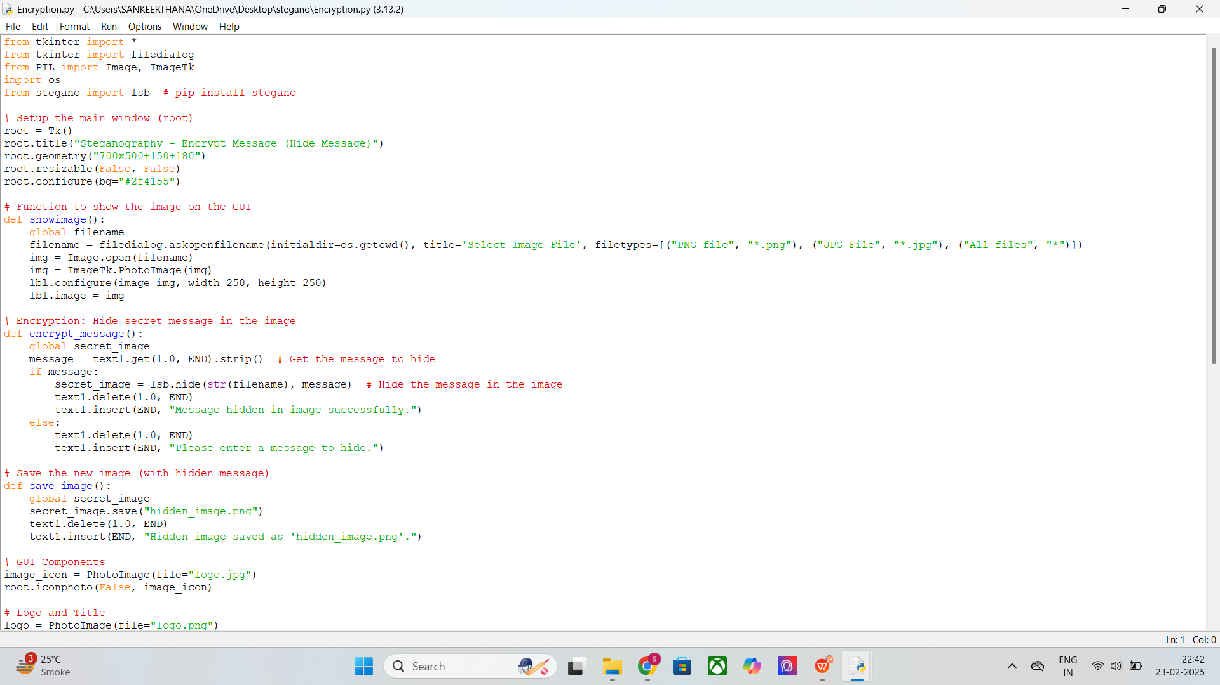
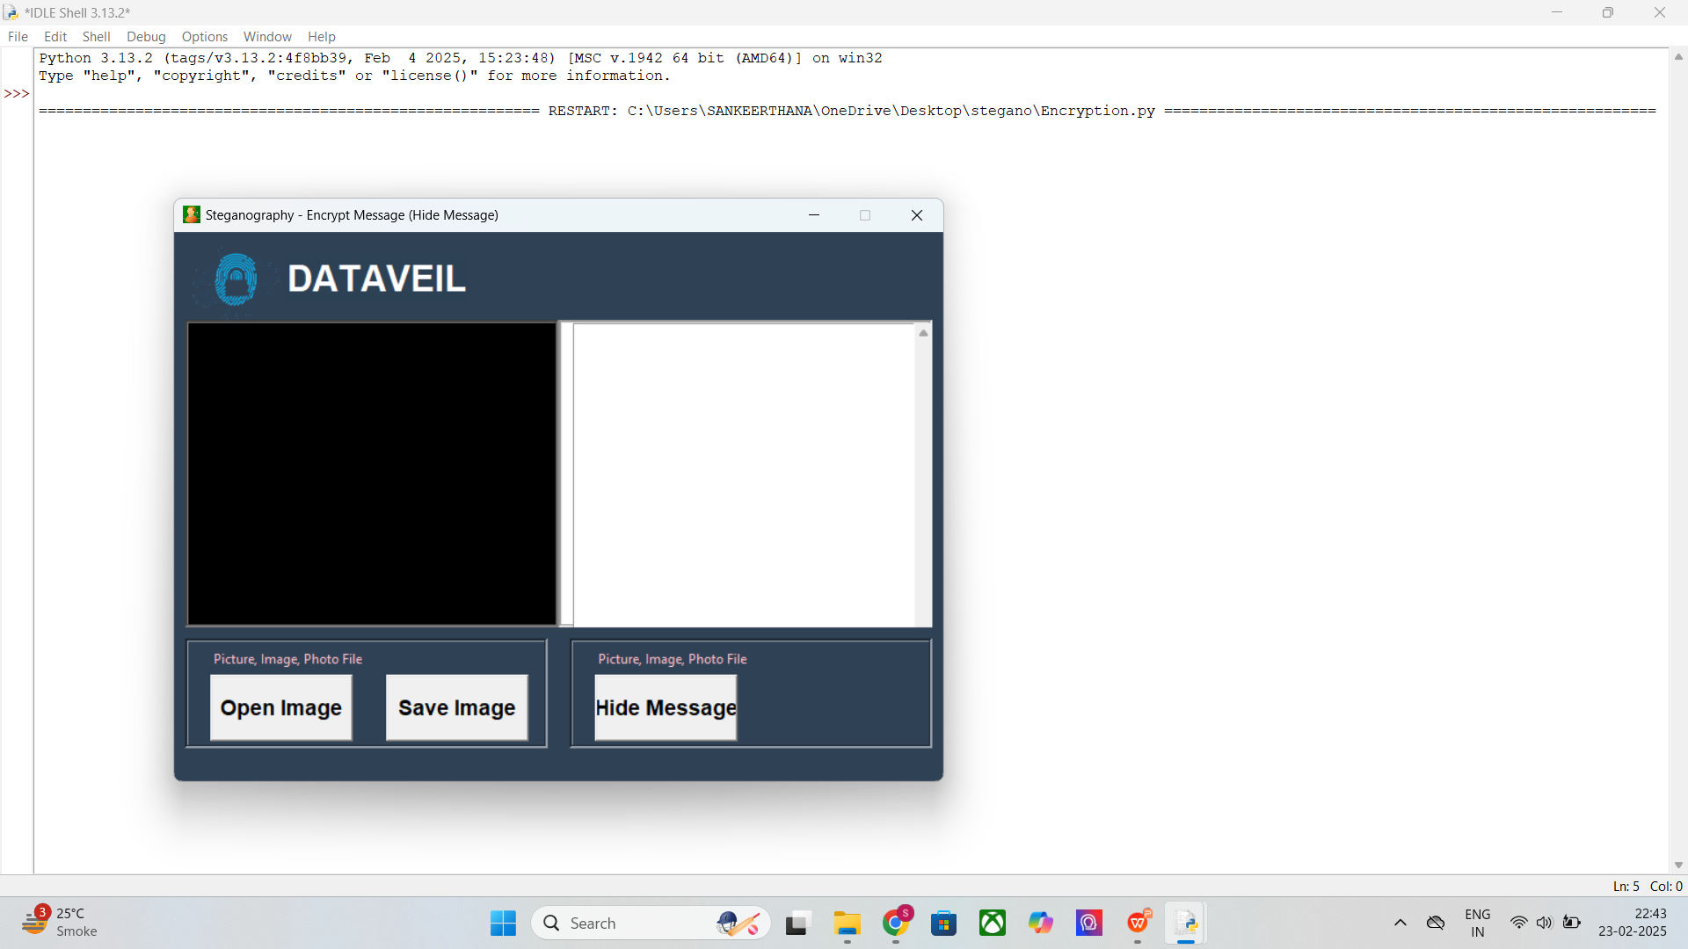
Results (ENCRYPTION OUTPUT)

Slide 9
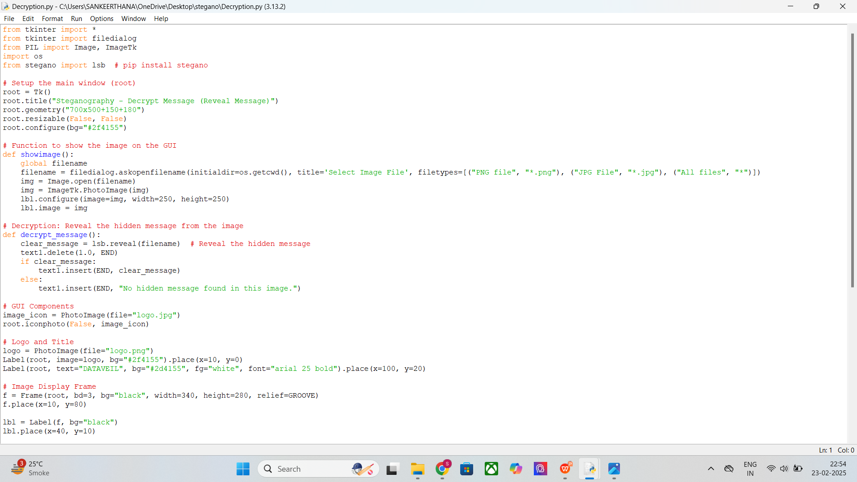
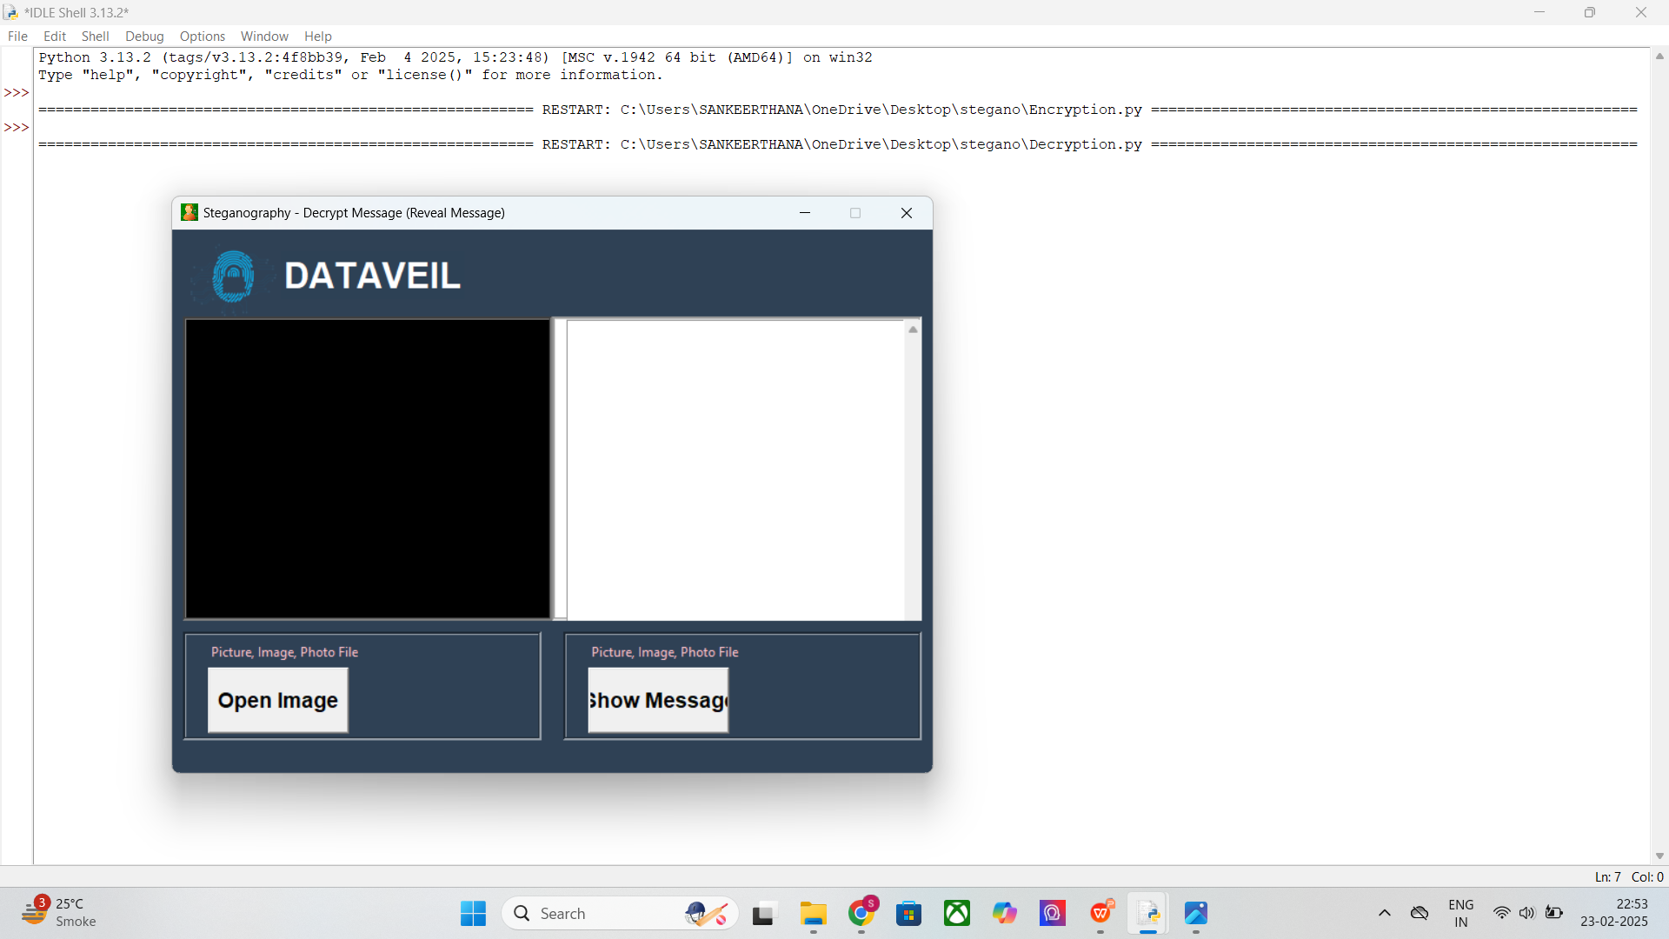
Decryption OUTPUT

Slide 10
Conclusion
The project developed here demonstrates the use of Steganography for hiding and revealing messages within images using Python. The functionality is split into two main parts: encryption (hiding a message in an image) and decryption (revealing a hidden message from an image). The steganography technique used in this project leverages the Least Significant Bit (LSB) method, which is a widely used technique for embedding data into the least significant bits of image pixels.
This project provides a simple and effective solution for embedding secret messages within images, offering users a secure way to communicate without revealing their messages to the naked eye. The use of the LSB method in image steganography makes this technique highly effective for a variety of real-world applications, such as secure communication and digital watermarking. By leveraging Python's Tkinter library, this project also provides an intuitive GUI that enhances user interaction.

Slide 11
GitHub Link
https://github.com/Sankeerthana-Boini/steganography.git

Slide 12
Future scope(optional)
1. Stronger Security Features
2. Support for More File Formats
3. Enhanced User Interface (UI) Features
4. Handling Larger Messages
5. Steganalysis and Detection
6. Integration with Cloud Storage and Social Media
7.Advanced Image Processing Features
8.Cross-Platform Compatibility

Slide 13
THANK YOU

